Slide 1
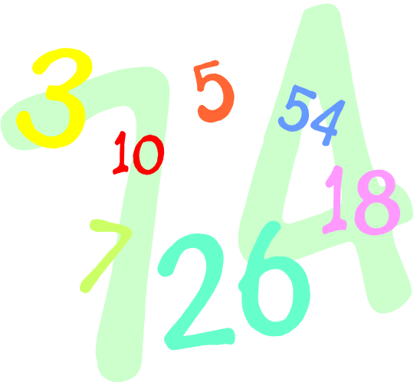
ST. BERNADETTE’S
Key Stage Two Mathematics Workshop

Slide 2
On a scale of 0-10, how much do you honestly enjoy mathematics?

Slide 3
Research suggests that as many as 60% of adults would rather clean the toilet than work out a maths problem.
An even larger percentage say:
I was never any good at maths.

Slide 4
It may come as a surprise that almost half of the working-age population (17 million) of England have numeracy skills equivalent to those expected for an 11 year-old child.
Adults with poor numeracy skills are twice as likely to be unemployed than those who enjoy some competency in numeracy.
Those adults with at least basic numeracy skills can expect to earn a quarter more than those who lack the necessary skills to solve basic mathematical problems.

Slide 5
At St. Bernadette’s, our aim is to enable every child to secure the mathematical skills they need at primary school in order to succeed at senior school and beyond: we thank you for your continued support in our endeavour.
Key messages shared with children:
maths is all around us and is a part of every day life;
maths is not a subject confined to a school book or classroom- it is a life skill;
everyone, with hard work, can achieve success in maths;
making mistakes is good because it means we are learning;
we use lots of different equipment and drawing to help us 'see' the maths;
speed is not important- fluency (depth of understanding) is;
talking about our learning helps us to understand and
getting stuck is good: it builds resilience.

Slide 6
Please don't feel embarrassed if
you don't understand the methods your child is using.
Teachers are here today to explain methods.

Slide 7
National Curriculum – Years 3 and 4
Ensure pupils become increasingly fluent with whole numbers and the four operations including number facts and the concept of place value. This should ensure that pupils develop efficient written and mental methods and perform calculations accurately with increasingly large whole numbers.
Pupils should develop their ability to solve a range of problems, including with simple fractions and decimal place value.
Pupils should draw with increasing accuracy and develop mathematical reasoning so they can analyse shapes and their properties, and confidently describe the relationships between them.
Ensure pupils can use measuring instruments with accuracy and make connections between measure and number.
By the end of year 4, pupils should have memorised their multiplication tables up to and including the 12s, and show precision and fluency in their work.
Pupils should read and spell mathematical vocabulary correctly and confidently, using their growing word reading knowledge and their knowledge of spelling.

Slide 8
National Curriculum – Years 5 and 6
Ensure that pupils extend their understanding of the number system and place value to include larger integers.
Pupils should develop connections between multiplication and division to support fractions, decimals, percentages and ratio.
At this stage, pupils should develop their ability to solve a wider range of problems, including increasingly complex properties of numbers and arithmetic, and problems demanding efficient written and mental methods of calculation.
With this foundation in arithmetic, pupils are introduced to the language of algebra as a means for solving a variety of problems.
Work in geometry and measures should consolidate and extend knowledge developed in number.
Pupils should classify shapes with increasingly complex geometric properties and learn the vocabulary needed to describe them.
By the end of year 6, pupils should be fluent in written methods for all four operations, including long multiplication and division, and in working with fractions, decimals and percentages. Pupils should read, spell and pronounce mathematical vocabulary correctly.

Slide 9
6 x 4
24
One of the most important things you can do to help your child is to support them in learning their tables.

Slide 10
“But I have tried and tried…”
A few children find it almost impossible to retain times tables so they need other strategies.
However, most children can learn 2s, 5s and 10s.
Then try to encourage your child to learn all the square numbers e.g.:
2x2, 3x3, 4x4, 5x5 etc.
This will give them a good starting point.
Notes:
All tables

Slide 11
The red numbers indicate how many tables you know if you know 2s, 5s 10s and square numbers.
x | 1 | 2 | 3 | 4 | 5 | 6 | 7 | 8 | 9 | 10 | 11 | 12
1 | 1 | 2 | 3 | 4 | 5 | 6 | 7 | 8 | 9 | 10 | 11 | 12
2 | 2 | 4 | 6 | 8 | 10 | 12 | 14 | 16 | 18 | 20 | 22 | 24
3 | 3 | 6 | 9 | 12 | 15 | 18 | 21 | 24 | 27 | 30 | 33 | 36
4 | 4 | 8 | 12 | 16 | 20 | 24 | 28 | 32 | 36 | 40 | 44 | 48
5 | 5 | 10 | 15 | 20 | 25 | 30 | 35 | 40 | 45 | 50 | 55 | 60
6 | 6 | 12 | 18 | 24 | 30 | 36 | 42 | 48 | 54 | 60 | 66 | 72
7 | 7 | 14 | 21 | 28 | 35 | 42 | 49 | 56 | 63 | 70 | 77 | 84
8 | 8 | 16 | 24 | 32 | 40 | 48 | 56 | 64 | 72 | 80 | 88 | 96
9 | 9 | 18 | 27 | 36 | 45 | 54 | 63 | 72 | 81 | 90 | 99 | 108
10 | 10 | 20 | 30 | 40 | 50 | 60 | 70 | 80 | 90 | 100 | 110 | 120
11 | 11 | 22 | 33 | 44 | 55 | 66 | 77 | 88 | 99 | 110 | 121 | 132
12 | 12 | 24 | 36 | 48 | 60 | 72 | 84 | 96 | 108 | 120 | 132 | 144
Notes:
The red numbers indicate how many tables you know if you know 2s, 5s 10s and square numbers.

Slide 12
The red numbers indicate how many tables you know if you know 2s, 5s 10s, square numbers and prime numbers.
x | 1 | 2 | 3 | 4 | 5 | 6 | 7 | 8 | 9 | 10 | 11 | 12
1 | 1 | 2 | 3 | 4 | 5 | 6 | 7 | 8 | 9 | 10 | 11 | 12
2 | 2 | 4 | 6 | 8 | 10 | 12 | 14 | 16 | 18 | 20 | 22 | 24
3 | 3 | 6 | 9 | 12 | 15 | 18 | 21 | 24 | 27 | 30 | 33 | 36
4 | 4 | 8 | 12 | 16 | 20 | 24 | 28 | 32 | 36 | 40 | 44 | 48
5 | 5 | 10 | 15 | 20 | 25 | 30 | 35 | 40 | 45 | 50 | 55 | 60
6 | 6 | 12 | 18 | 24 | 30 | 36 | 42 | 48 | 54 | 60 | 66 | 72
7 | 7 | 14 | 21 | 28 | 35 | 42 | 49 | 56 | 63 | 70 | 77 | 84
8 | 8 | 16 | 24 | 32 | 40 | 48 | 56 | 64 | 72 | 80 | 88 | 96
9 | 9 | 18 | 27 | 36 | 45 | 54 | 63 | 72 | 81 | 90 | 99 | 108
10 | 10 | 20 | 30 | 40 | 50 | 60 | 70 | 80 | 90 | 100 | 110 | 120
11 | 11 | 22 | 33 | 44 | 55 | 66 | 77 | 88 | 99 | 110 | 121 | 132
12 | 12 | 24 | 36 | 48 | 60 | 72 | 84 | 96 | 108 | 120 | 132 | 144
Notes:
The learn the prime numbers.

Slide 13
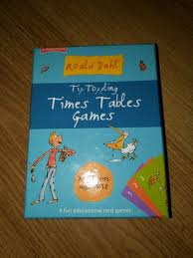
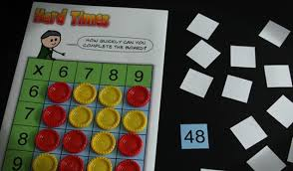
The government has introduced a times tables test for Year 4. Children will be expected to know up to 12 x 12 including associated division facts.

Slide 14
Expectations in Years 5 and 6
540 ÷ 90 620 ÷ 0.5
18 x 12 470 x 0.5
5/7 of 350 700 x 0.9
8 x 0.7 180 ÷ 6

Slide 15
Look at this calculation. Oh no, not division!
45,505,525 ÷ 5
Times tables and place value are really important for success with division.
Notes:
It looks really challenging but given time to look and analyse most children will come to the conclusion that it is not difficult and this will give them the confidence to tackle other calculations.
9,000,000 + 100,000, + 1000, + 100 + 5

Slide 16
There are lots of ways to learn.
There is no single, exclusively correct learning style in mathematics. We learn things in a variety of ways.
How would you do this calculation?
57 - 29

Slide 17
4 1
57
29
28
- 30 + 1
+1 +27 57
30
-20 -2 -7 57
28 48 50
29 = 20 + 7 + 2
Notes:
Children need to develop a secure understanding at each level in order to refine their strategies.

Slide 18
What would children need to be able to do in order to be successful with this calculation?
57 – 29

Slide 19
Counting back strategy
Number bonds
Subtracting a single-digit number from a tens number
Subtracting a multiple of ten from any number
Partitioning numbers efficiently
Combining numbers to calculate a total
-20 -2 -7 57
28 48 50
29 = 20 + 7 + 2
Notes:
Acquisition of basic skills helps calculation at every level.

Slide 20
Counting up strategy
Number bonds to ten
Adding a multiple of ten to any number
Combining numbers to find a total
Understanding the finding the difference model.
+1 +20 + 7 57
30 50
Notes:
Children need to understand that there are two models for subtraction – the taking away model and the comparison or finding the difference model.

Slide 21
40
50 1 7
- 20 9
20 8
Children need to know that numbers can be partitioned in different ways to aid calculation.
4 1
57
29
28
Notes:
Children use the expanded column method before moving on to the formal column method in order to develop a secure understanding. It is imperative that children really understand what they are doing when carrying out column methods.

Slide 22
57 – 29
This is a higher order strategy and not all children will be able to work in this way so they need a secure strategy that works for them.
- 30 + 1
Notes:
Not all children will have access to these higher order strategies but they need a secure strategy that works for them.

Slide 23
Counting is a crucial skill.
- Helps pupils to make sense of the number system at all stages; whole numbers, decimals and fractions.
- Helps them to calculate.
Cakes cost 25p each plus 20p for the bag they are packaged in.
Jay paid £2.95 for a bag of cakes.
How many cakes did he buy?
Children can easily solve a problem like this when they are used to counting in 25s and have made the connection between 25 and 100.
Notes:
We need to make sure that we value counting

Slide 24
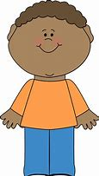
Fractions
Fractions have a very high profile within the Primary Curriculum.
Children begin to learn about fractions before they come into school. They have a great sense of fairness:
Well, I am older. I am 4 ½.
That is not half. She has got more than me.
I am 4.

Slide 25
What basic skills will really support children’s success with fractions?
Times tables
Knowing common multiples and factors

Slide 26
Think about how tables knowledge can support work in fractions
6/7 – 3/8
A child who is confident with the 7 and 8 times tables will be more successful here.

Slide 27
Times table knowledge also supports work with shape
A regular hexagon has a perimeter of 42cm.
What is the length of each side?

Slide 28
It is crucial that children can explain their thinking using the appropriate vocabulary. This not only embeds their own learning but supports the learning of others through hearing quality explanation.

Slide 29
Venn Diagram
Prime numbers Square numbers
Even numbers
Tom said that he could put any number you gave him in one of the segments. Is Tom correct?
Notes:
Children can panic when things look difficult. Giving them time to just observe and comment about what they can see takes the fear away. It encourages them to think about what they know rather than what they don’t know

Slide 30
Expectations of vocabulary related to previous slide:
Even numbers
Odd numbers
Prime numbers
Square numbers
I know that 2 is the only even prime number but all even numbers will be able to go in the diagram either as square numbers or just even numbers.
I know the numbers that go outside of the diagram are any odd number that is not prime and not square. For example, 15.
I know 49 goes into this section because it is an odd square number but other odd numbers if they are not prime or square cannot go in the diagram so Tom is wrong.
Examples of children’s
reasoning above.
Notes:
The acquisition of key vocabulary is essential to enable children to explain their learning efficiently and confidently.
Asking children to explain their strategies and ideas helps to embed their learning.
Speaking in full sentences is important because it ensures children are putting learning into a context.
Asking children to draw their understanding provides strong evidence for assessment and also embeds learning.

Slide 31
The government assess Key Stage Two mathematics when pupils are in Year 6. The SATs take place in May and out of the 6 tests to be completed, 3 are mathematical: 1 x arithmetic 2 x reasoning. Last year’s SATs showed that 12% of questions pertained to the Y3 curriculum, 19% Y4, 23% Y5 and 46% Y6.

Slide 32
What skills have we looked at so far?
Understanding odd and even numbers
Halving and doubling
Knowing and using number bonds to aid calculation
Partitioning numbers to support calculation
Adding and subtracting multiples of ten
Subtracting single digit numbers from multiples of 10
Using mathematical vocabulary
Knowing square numbers
Effect of dividing by one and the same number
Times tables
Using factors and multiples
Your support with learning these skills is invaluable for your child.

Slide 33
Homework
There is far more emphasis in the new curriculum on basic skills and homework will reflect this.
Expect your child to be asked to practise and consolidate basic skills on a regular basis.
Homework activities may be based on achieving accuracy or striving for pace.

Slide 34
How can I help my child at home?
Create a positive view of mathematics – be mathematicians together.
Learn times tables.
Support your child in learning to tell the time.
Help your child to learn ‘general knowledge’ maths facts such as how many days are in each month, how many hours there are in a day etc.
Help your child to understand the importance of mathematics in everyday life.
Support your child when learning basic skills such as number bonds, counting in equal steps and tables.
Value homework activities even if you think your child knows it. They must be fluent and able to apply the skills if learning is to be sustainable.

Slide 35
Games are an effective way to boost numeracy.

Slide 36
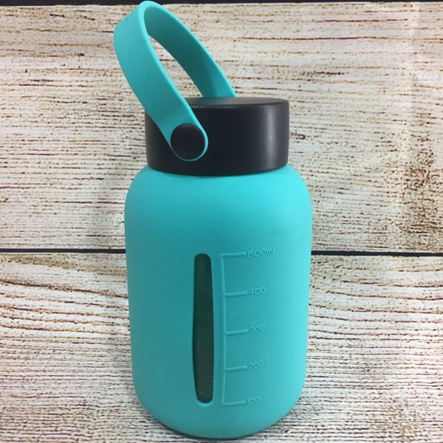
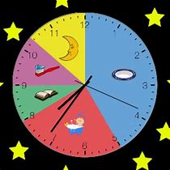
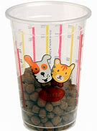
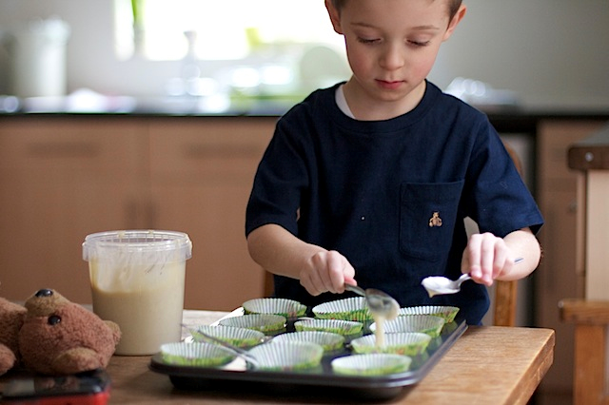
Closing thoughts…
Maths is everywhere which means we have endless opportunities to encourage children to become confident mathematicians just through our discussions and questions.

